Slide 1
WEEK 7 · LECTURE 13
Building a Support Copilot
Part 1: the layer that reads
5,000 tickets a week, three agents, and nothing in the queue has ever been sorted. Let's ship anyway.
ISBA 2411 · Natural Language Processing & AI · Summer 2026

Slide 2
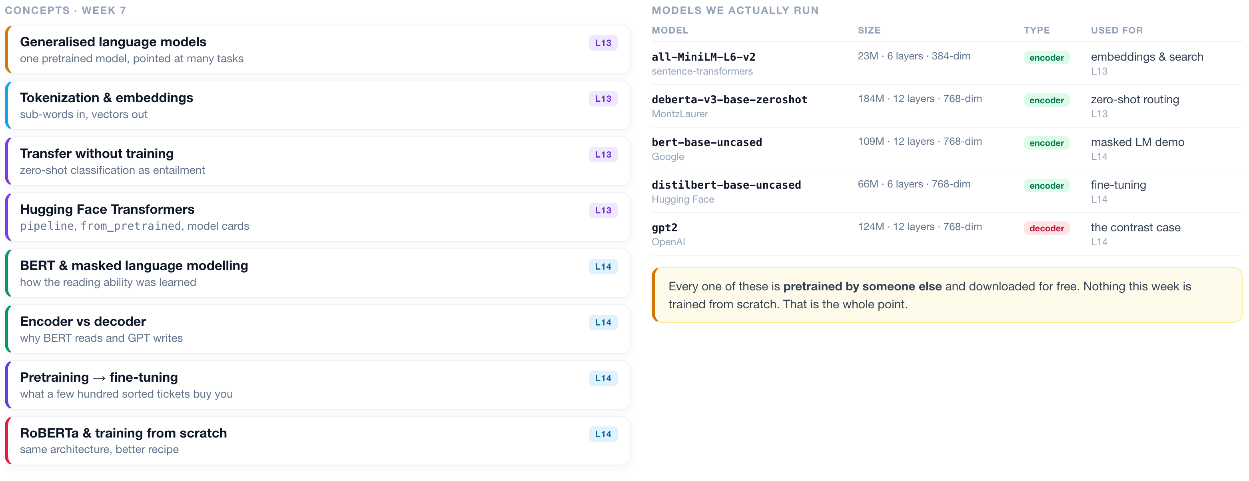
WEEK 7 · AT A GLANCE
Language Models & Transformers
What we cover across both lectures, the models we actually run, and what to read alongside them.
READINGS
J&M Ch. 7 Large Language Models
J&M Ch. 10 BERT & masked LMs
HOLLM Ch. 3 inside transformer LLMs
Tunstall Ch. 10 training from scratch
Vaswani 2017 Attention Is All You Need
Devlin 2018 BERT
Liu 2019 RoBERTa
ISBA 2411 · Natural Language Processing & AI · Summer 2026

Slide 3
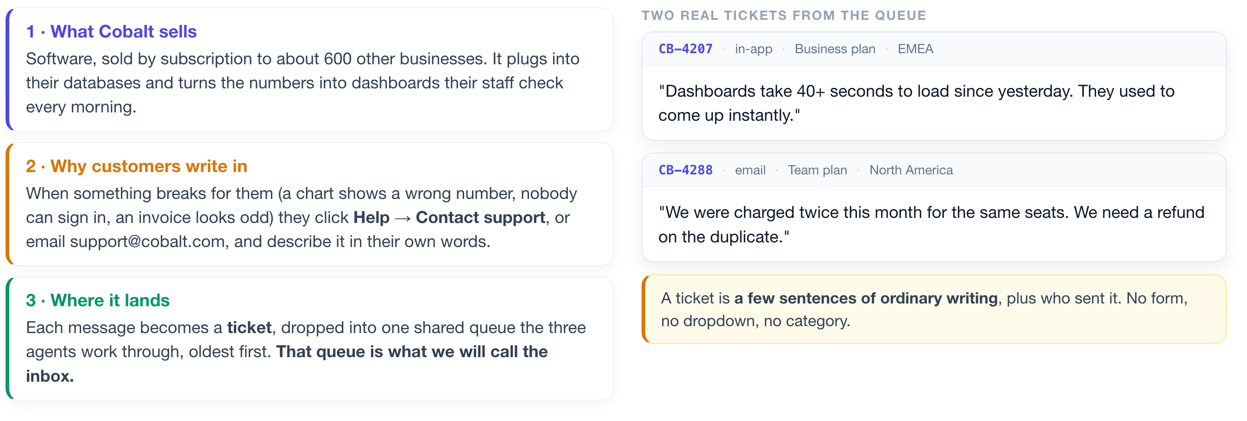
THE BUSINESS
First, what company are we walking into?
Before any technology, you need to be able to picture the job. Here it is in three sentences.
Five thousand of these arrive every week. Three people answer them.
ISBA 2411 · Natural Language Processing & AI · Summer 2026

Slide 4
THE PROBLEM
Every ticket has to be read before it can be answered.
And that reading is where the three agents lose their day.
~5,000 tickets a week
~40% are repeats
Nothing is sorted
Minutes lost per ticket
and three people to answer them
the same handful of questions
no tags, no categories, just text
just working out who should own it
WHY THAT THIRD BOX IS THE HARD ONE
The normal way to teach a computer to sort text is to hand it a few thousand examples that a person has already sorted by hand. Those hand-sorted examples are called training data, and most machine learning cannot start without them. Cobalt has none. Building that pile would mean paying people to read and tag thousands of tickets before you could write a line of code.
So tonight we build something that never needs them. We start with the half that READS the inbox: search it, sort it, and decide what a person actually has to see.
ISBA 2411 · Natural Language Processing & AI · Summer 2026

Slide 5
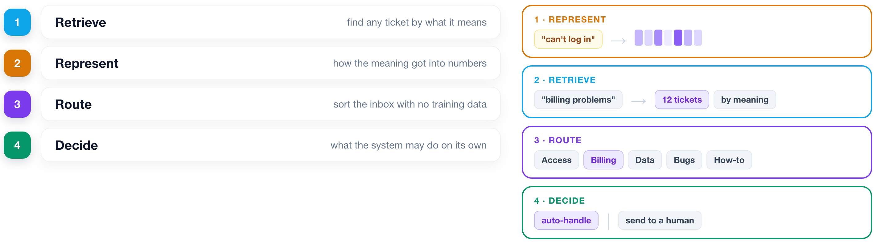
THE PLAN
Four capabilities, built in order.
Each one is useful on its own. Together they are a product.
ISBA 2411 · Natural Language Processing & AI · Summer 2026

Slide 6
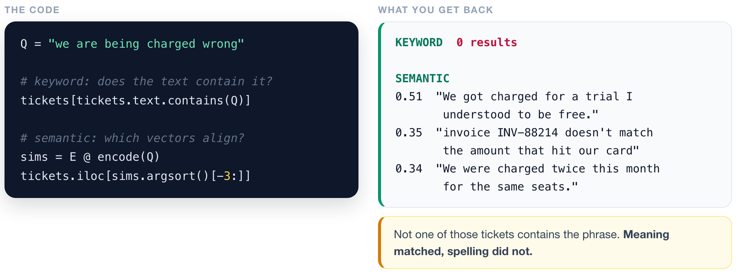
RETRIEVE
1
2
3
4
Search that finds what you meant.
Before any theory: watch it find tickets that do not contain a single word you typed.
▶ NOTEBOOK
STEP 3
Turn tickets into vectors, then search
ISBA 2411 · Natural Language Processing & AI · Summer 2026

Slide 7
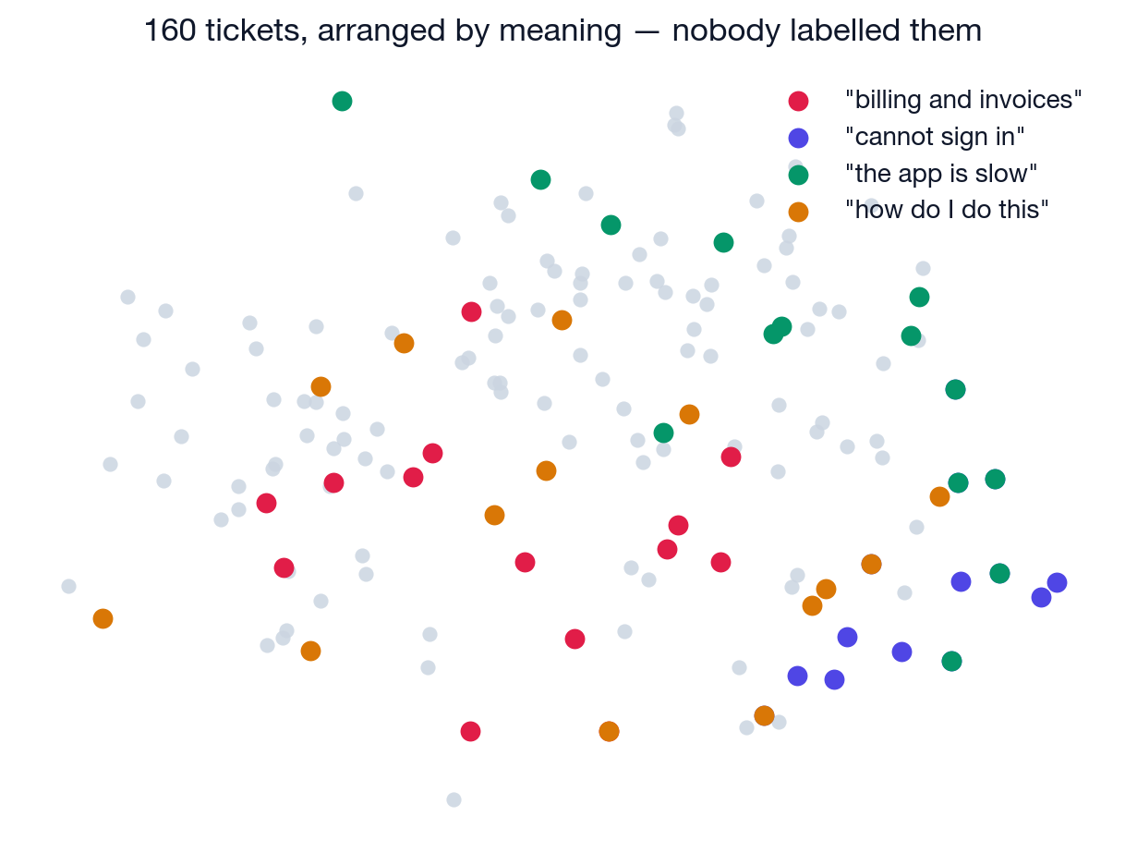
RETRIEVE
1
2
3
4
Structure was already in the text.
Nobody sorted these. Plot the tickets and the neighbourhoods appear on their own.
▶ NOTEBOOK
STEP 5
Map the whole inbox
ISBA 2411 · Natural Language Processing & AI · Summer 2026

Slide 8
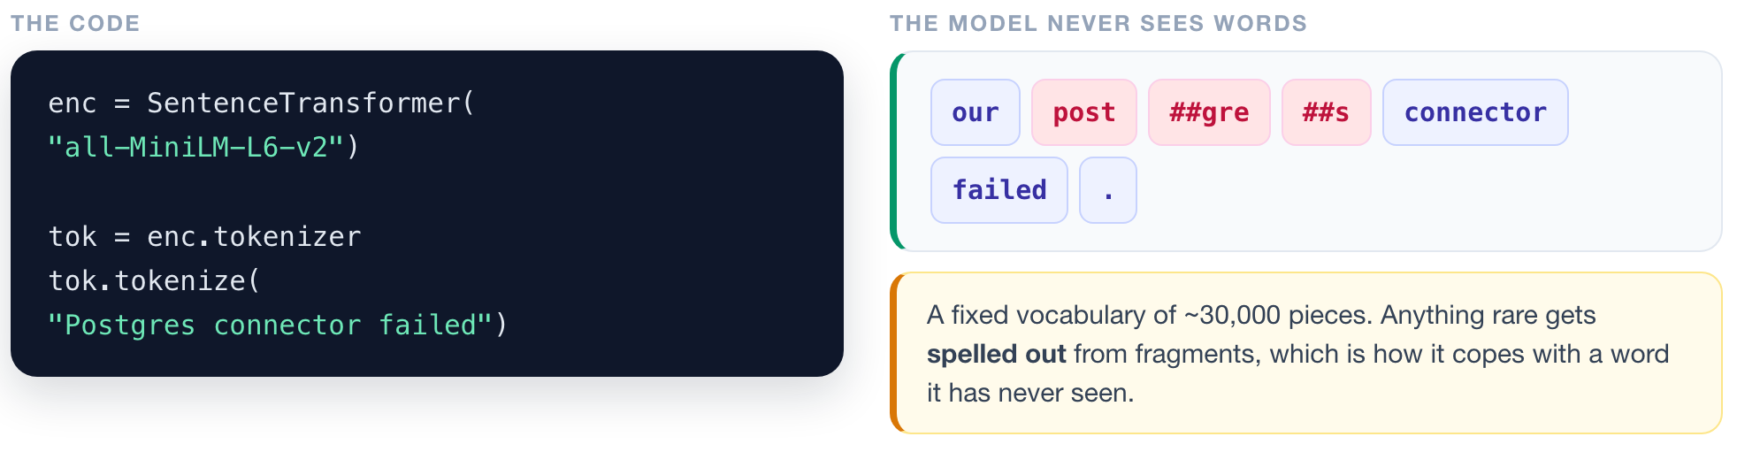
REPRESENT
1
2
3
4
So how did it do that?
To answer that we go all the way down: a model cannot read, so the text has to become numbers first.
▶ NOTEBOOK
STEP 6
Split text into tokens
ISBA 2411 · Natural Language Processing & AI · Summer 2026

Slide 9
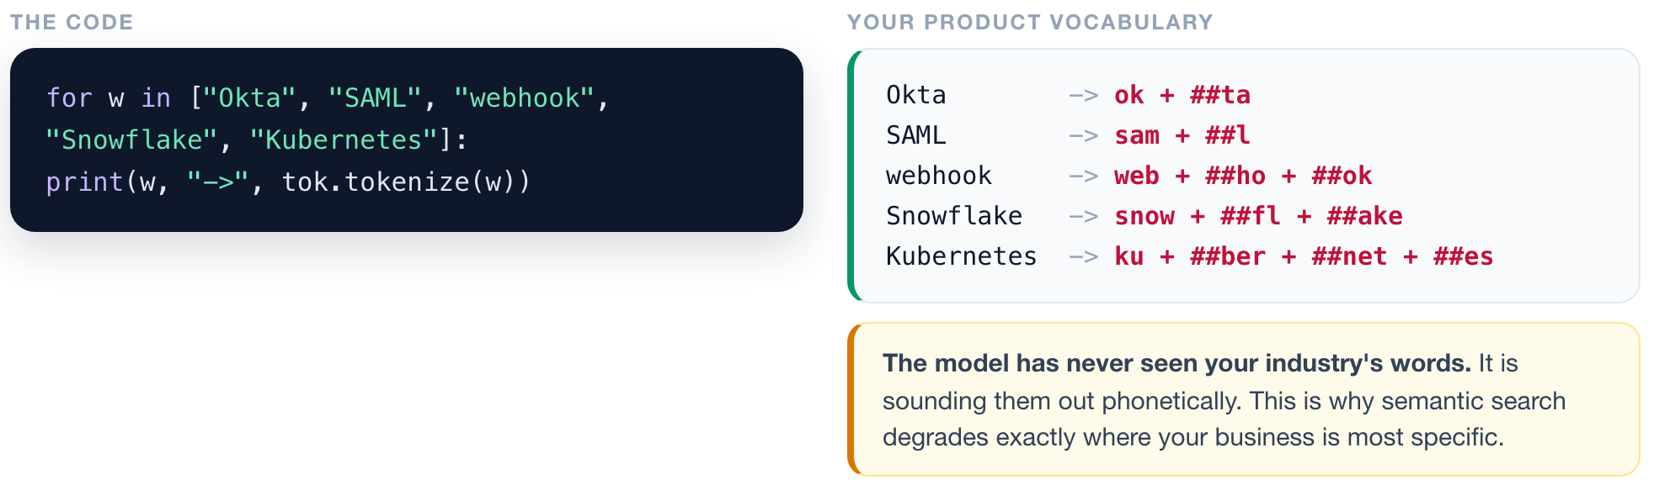
REPRESENT
1
2
3
4
Check what happens to your business vocabulary.
▶ NOTEBOOK
STEP 7
Test your product vocabulary
ISBA 2411 · Natural Language Processing & AI · Summer 2026

Slide 10
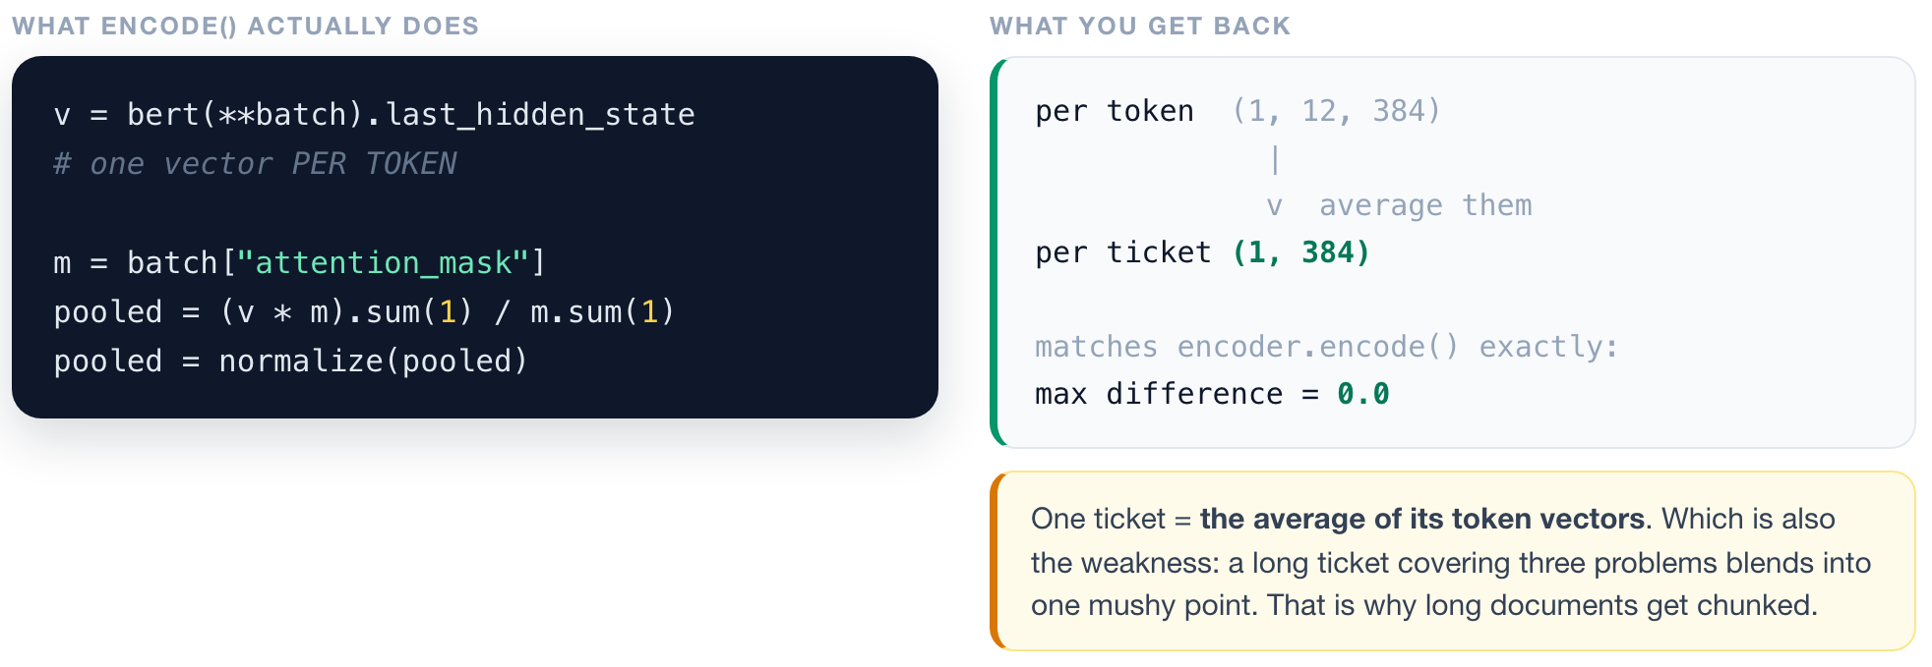
REPRESENT
1
2
3
4
One ticket becomes one vector, by averaging.
And because every vector has length 1, the similarity behind that search is a plain multiplication.
▶ NOTEBOOK
STEP 8
Pool tokens into one vector
ISBA 2411 · Natural Language Processing & AI · Summer 2026

Slide 11
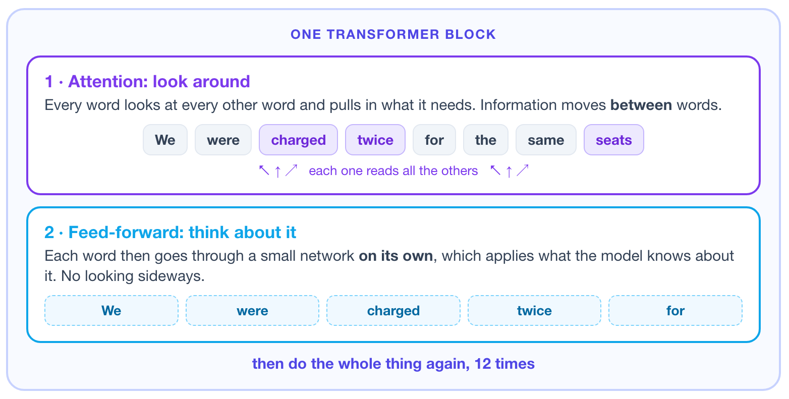
REPRESENT
1
2
3
4
You built this in Lecture 11.
Here is the ninety seconds of it that matter today: attention looks around, feed-forward thinks about it.
ATTENTION MOVES MEANING
0.93 → 0.46
the word "plan" in two tickets: nearly identical going in, barely related coming out
FEED-FORWARD HOLDS KNOWLEDGE
67% / 33%
two thirds of every layer is feed-forward, not attention. "billed every ___" → month
▶ NOTEBOOK
STEP 9
Watch attention change a word
ISBA 2411 · Natural Language Processing & AI · Summer 2026

Slide 12
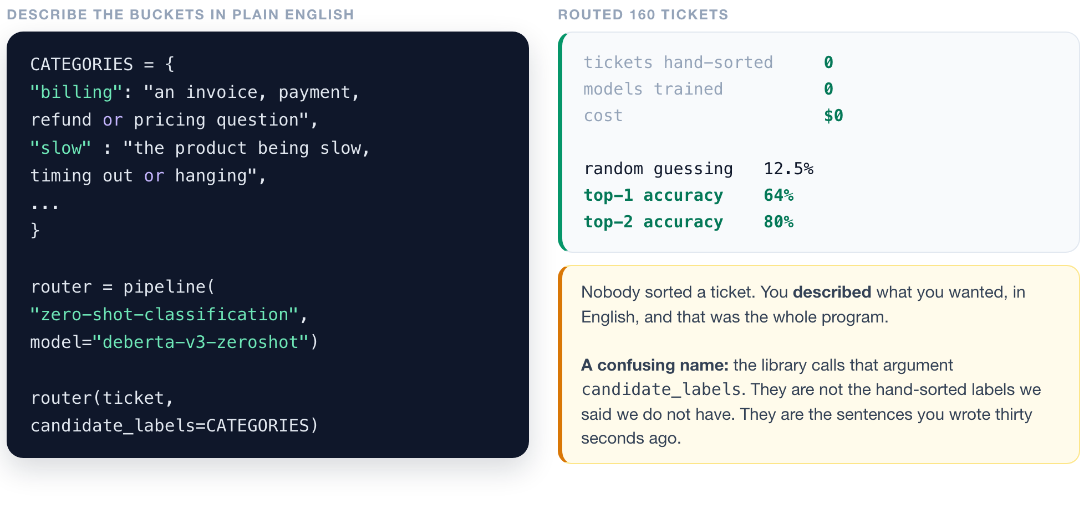
ROUTE
1
2
3
4
Sort the inbox with no training data at all.
▶ NOTEBOOK
STEP 13
Route the inbox with no training data
ISBA 2411 · Natural Language Processing & AI · Summer 2026

Slide 13
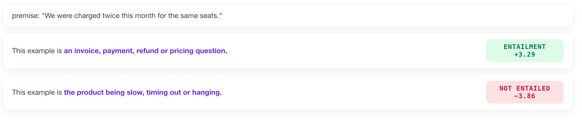
ROUTE
1
2
3
4
It is not a classifier. It is a fact-checker.
The model judges whether a sentence YOU wrote is true of the ticket.
Every category becomes a sentence: "This example is {your description}." The model scores all eight and picks whichever it most believes.
▶ NOTEBOOK
STEP 17
See the entailment scores
ISBA 2411 · Natural Language Processing & AI · Summer 2026

Slide 14
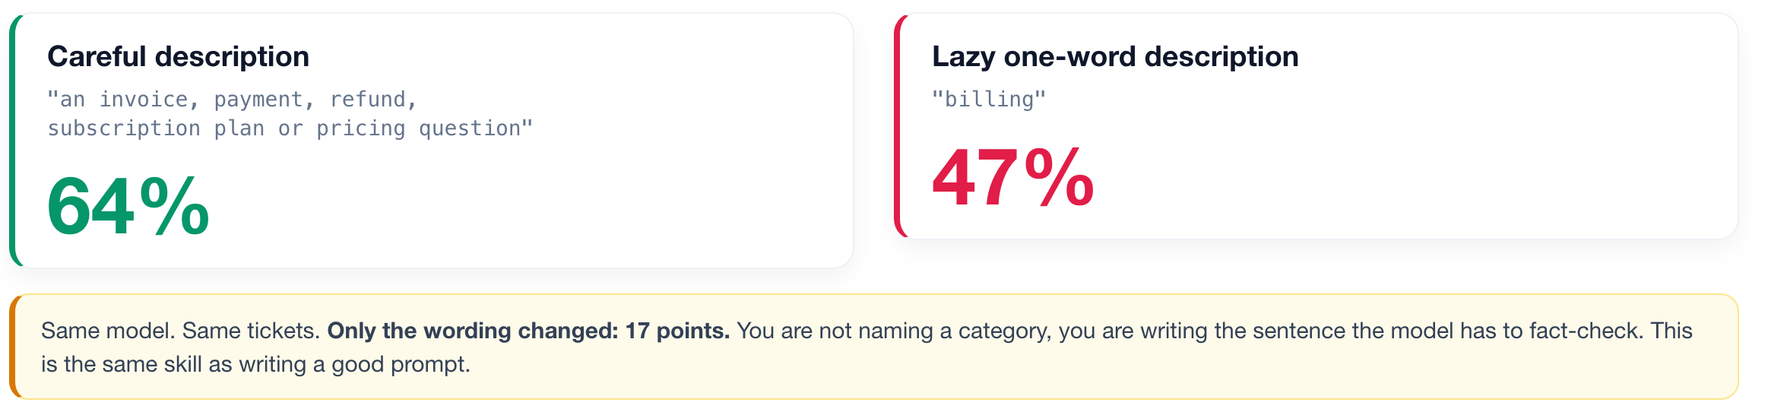
ROUTE
1
2
3
4
The descriptions you write ARE the program.
▶ NOTEBOOK
STEP 16
YOUR KNOB: rewrite the descriptions
ISBA 2411 · Natural Language Processing & AI · Summer 2026

Slide 15
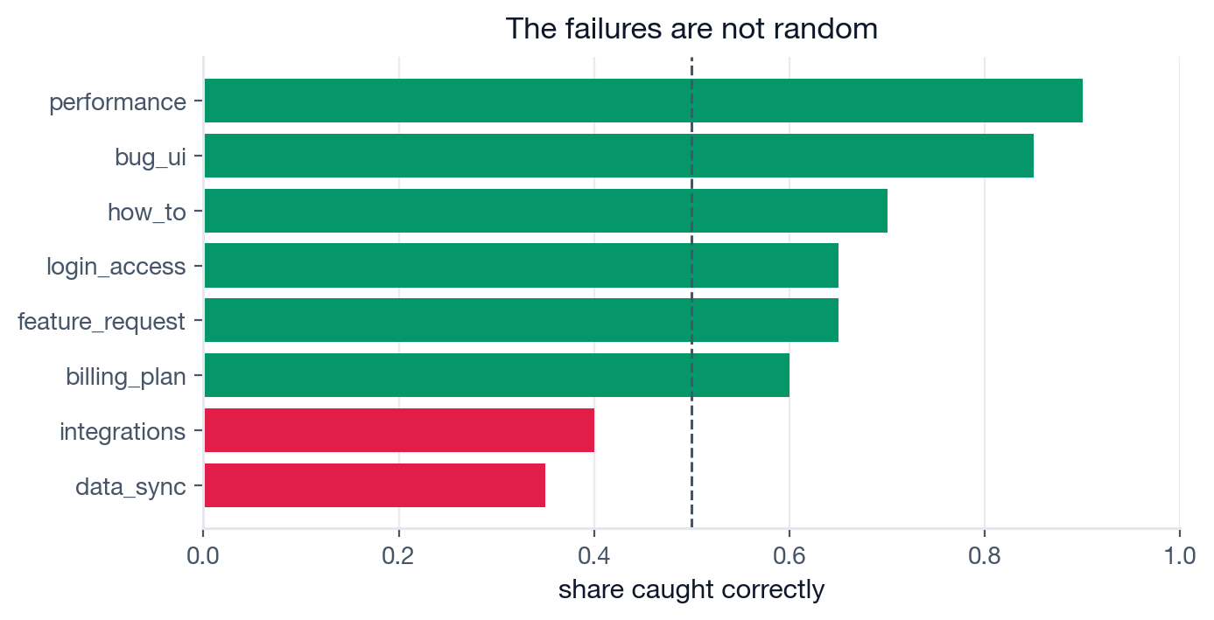
DECIDE
1
2
3
4
An average is a bad way to run a product.
Ask WHICH tickets it gets wrong. The weak buckets are the ones whose descriptions overlap.
When a classifier underperforms, look at your taxonomy before you look at your model.
▶ NOTEBOOK
STEP 18
Find the weak buckets
ISBA 2411 · Natural Language Processing & AI · Summer 2026

Slide 16
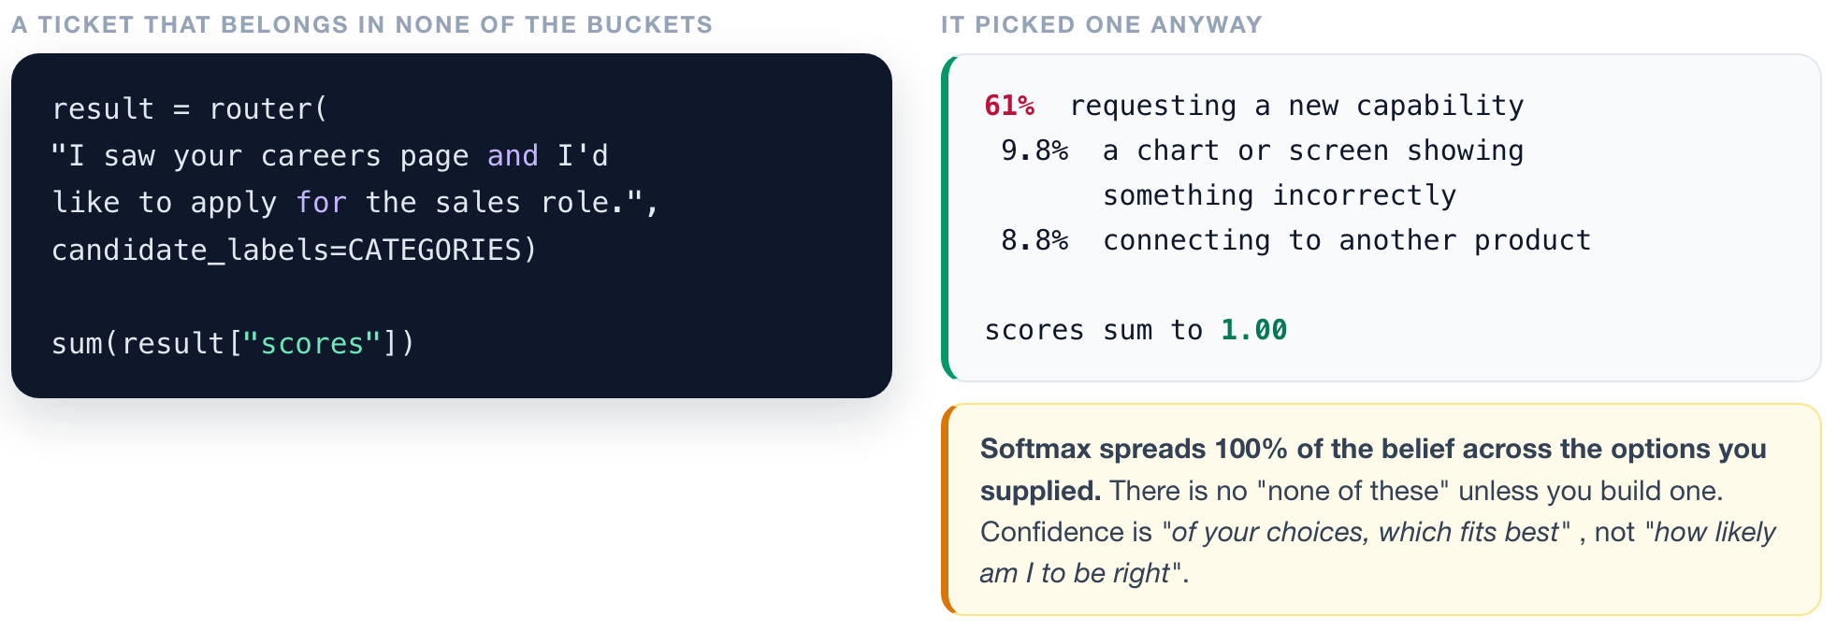
DECIDE
1
2
3
4
Confident is not the same as correct.
▶ NOTEBOOK
STEP 19
Feed it an off-topic ticket
ISBA 2411 · Natural Language Processing & AI · Summer 2026

Slide 17
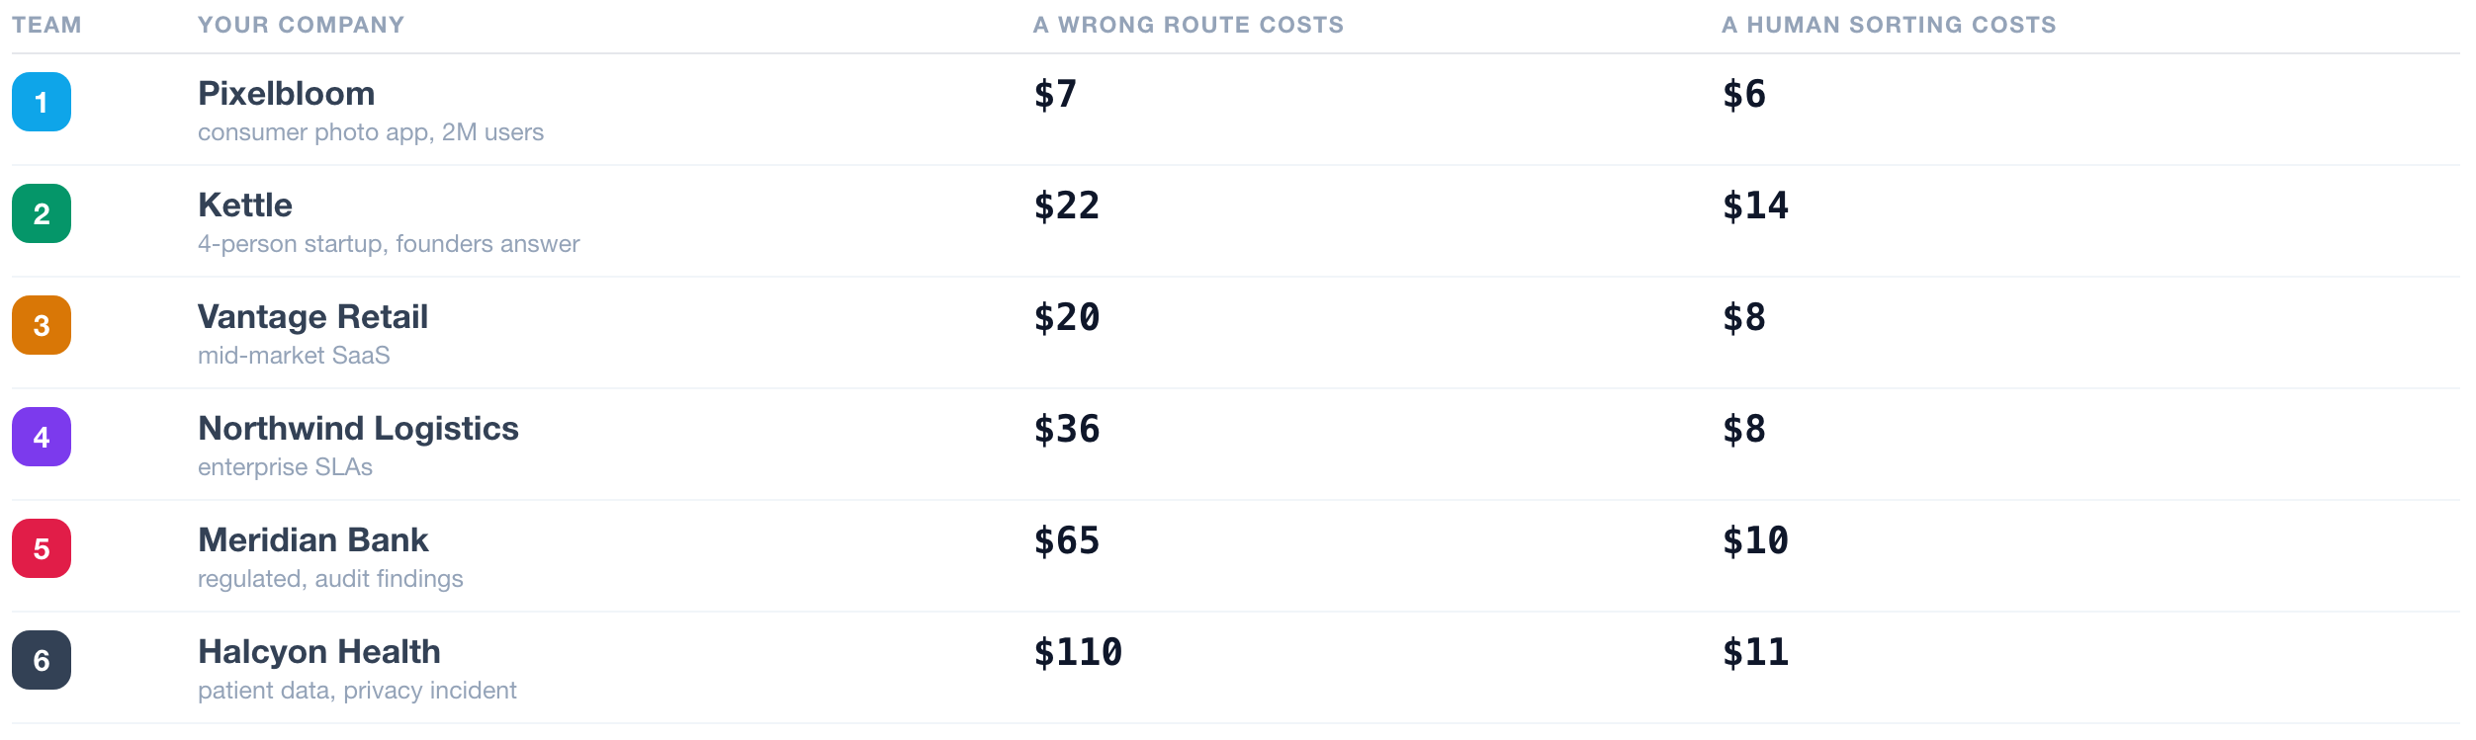
YOUR TURN
1
2
3
4
The Shipping Decision.
Same copilot. Same tickets. Your team runs it for a different company. Find the best setting for yours.
Open L13_Game_Shipping_Decision.ipynb · 12 minutes · scored on how close you get to the best setting for YOUR company, not on raw dollars.
ISBA 2411 · Natural Language Processing & AI · Summer 2026

Slide 18
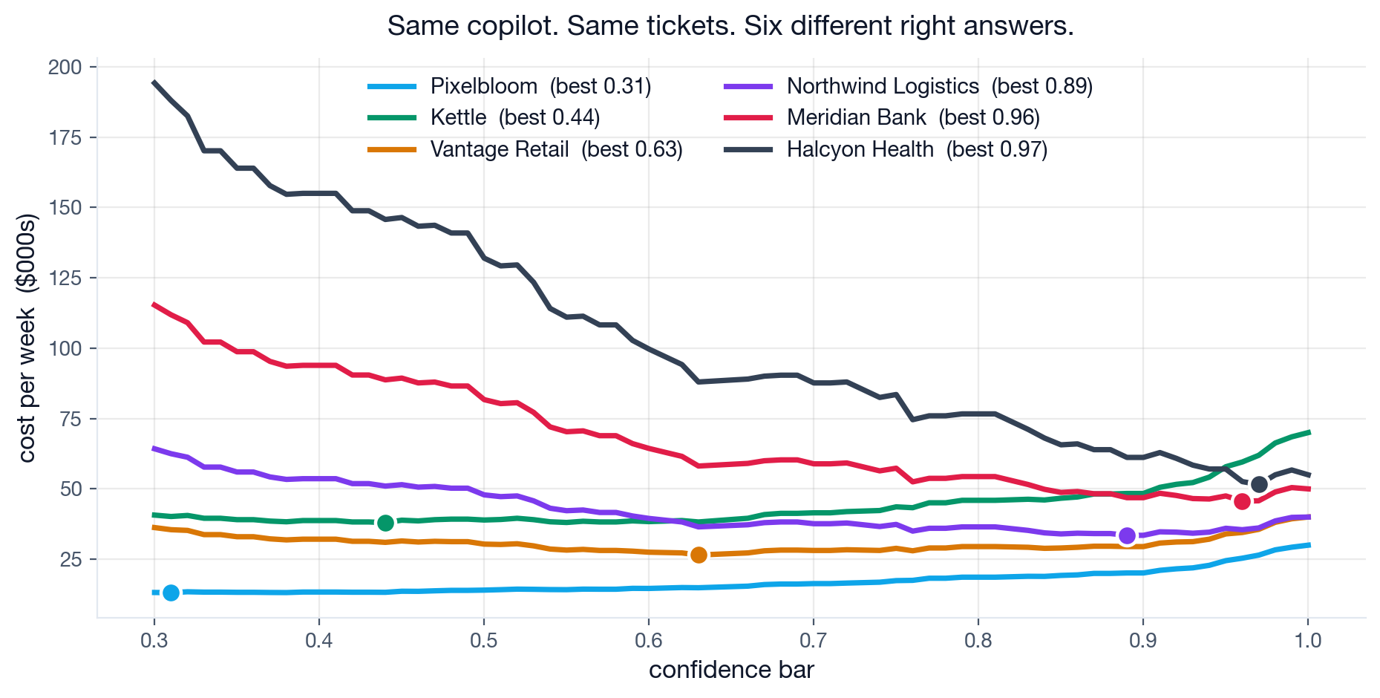
THE REVEAL
1
2
3
4
Every team optimised correctly. Every team got a different answer.
Nobody had a better model. The only thing that changed was what a mistake costs.
ISBA 2411 · Natural Language Processing & AI · Summer 2026

Slide 19
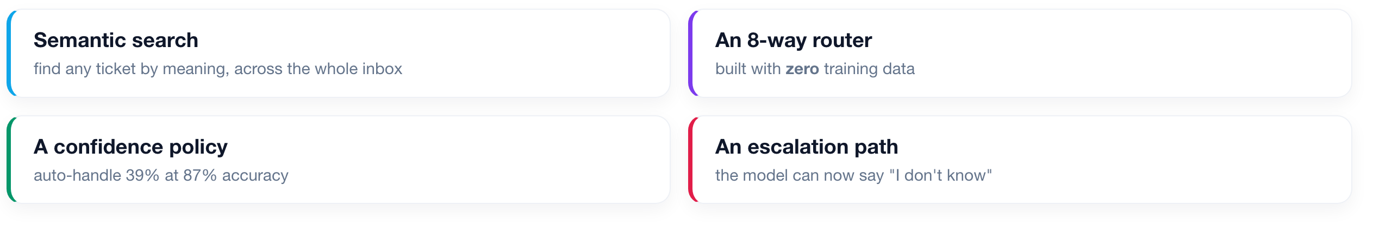
FULL CIRCLE
What we shipped today, for $0.
No training data. No training run. No GPU bill. One afternoon.
Accuracy is a property of the model. The right threshold is a property of the business.
ISBA 2411 · Natural Language Processing & AI · Summer 2026

Slide 20
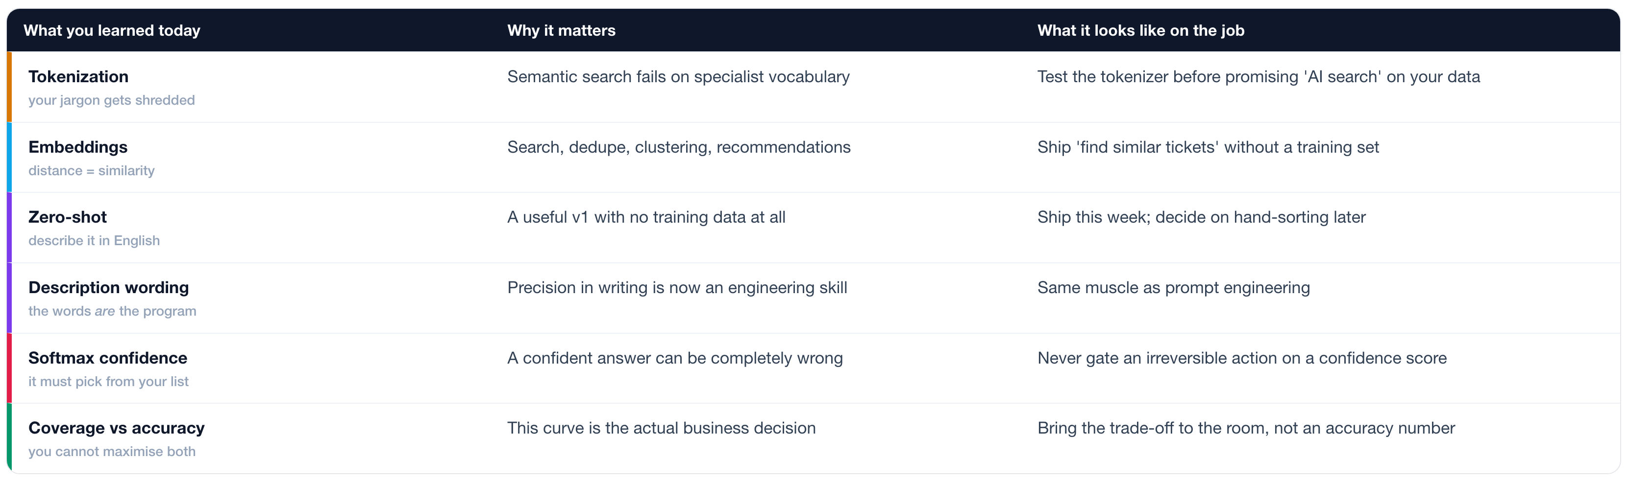
WHY THIS MATTERS AT WORK
Six instincts, not six tools.
Every row is a call your future team needs someone in the room able to make.
ISBA 2411 · Natural Language Processing & AI · Summer 2026

Slide 21
NEXT TIME
The layer that acts.
What if we DO sort them by hand?
a few hundred examples, and what they buy you
Where the reading came from
BERT, and how pretraining actually worked
Pull out the specifics
which feature, what error, which plan
Watch it make things up
and why that sets up Week 8
Notebook: L13_Cobalt_Support_Copilot.ipynb. Run it, turn the knobs, break it.
ISBA 2411 · Natural Language Processing & AI · Summer 2026

